Slide 1
PDA

Slide 2
PDA
Pushdown Automata
PDA is the Class of Automata associated with CFL
Finite Automata cannot recognize all context free languages as FA has strictly finite memory whereas the recognition of a CFL may require storing an unbounded amount of information.

Slide 3
PDA
Eg-
L={a^{n}b^{n}|n>=0}
When scanning the string, we must check that all a’s are preceding the first b, we also need to count the number of a’s
Since n is unbounded, this counting cannot be done with a finite memory.
We want a machine that can count without limit

Slide 4
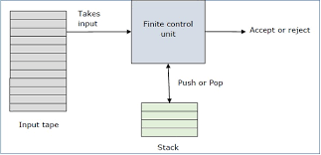
PDA
A pushdown automaton is −
"Finite state machine" + "a stack"
A pushdown automaton has three components −
an input tape,
a control unit, and
a stack with infinite size.
The stack head scans the top symbol of the stack.

Slide 5
Deterministic PDA: Formal Definition
A list of seven elements is called a 7-tuple,
A PDA can be defined as a 7-tuple

Slide 6
PDA: Formal Definition
PDA is denoted by 7 Tuple: M=(Q, ∑, ᴦ, δ, q₀, z, F) where
Q:Finite set of Internal states of the Control Unit
∑:Finite input alphabet
ᴦ: Finite Set of Stack Symbols/Pushdown symbols
δ:Q X (∑ U {ε}) X ᴦ ->Q X ᴦ *: Transition function(TF)
or
δ:Q X ∑_{ε} X ᴦ_{ε} ->Q X ᴦ_{ε} *
q₀: Start state of Control Unit, q0 ∈ Q
z : Stack start Symbol, z ∈ ᴦ, Initially present in the stack
F: Set of Final States/ Accept State, F ⊆ Q

Slide 7
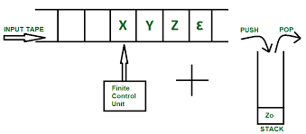
δ Function
δ Function:-
δ:Q X (∑ U {ε} X ᴦ ->Q X ᴦ *: Transition function(TF)
or
δ:Q X ∑_{ε} X ᴦ_{ε} ->Q X ᴦ_{ε} *

Slide 8
δ Function
δ Function:-
δ:Q X (∑ U {ε} X ᴦ ->Q X ᴦ *: Transition function(TF)
or
δ:Q X ∑_{ε} X ᴦ_{ε} ->Q X ᴦ_{ε} *
Domain-
The Arguments are :-
Current State of the control Unit
Current Input Symbol
Current Symbol on the Top of the stack
Range-
The Set of pair (q,x) where :-
q is Next state of the control Unit
x is a string which is put on the top pf the stack , in place of the single symbol there before

Slide 9
δ Function
δ Function:-
δ:Q X (∑ U {ε} X ᴦ ->Q X ᴦ *: Transition function(TF)
or
δ:Q X ∑_{ε} X ᴦ_{ε} ->Q X ᴦ_{ε} *
Domain-
The Arguments are :-
Current State of the control Unit
Current Input Symbol- Can be ε, indicating a move that does not consume an input symbol, Also called ε or Null Transition
Current Symbol on the Top of the stack- δ is defined so that it needs a stack symbol, no move is possible if the stack is empty

Slide 10
Instantaneous Description
Let M=(Q, ∑, ᴦ, δ, q₀, z, F) be a pda
An Instantaneous Description(ID) is (q,x,α)
where q ∈ Q, x ∈ ∑_{ε ,} α ∈ ᴦ_{ε}
q is the Current State of the control Unit
x is the Unread part of the input string/The part of the input to be processed
Say a1,a2,….an
The PDA will process in a1,a2,….an order only
α are the stack contents with the left most symbol indicating the top pf the stack
This triplet is called ID

Slide 11
Instantaneous Description
A move from one ID to another will be denoted by Turnstile notation
⊢ sign is called a “turnstile notation” and represents one move.

Slide 12
Move Relation-
Let M be a PDA
A move relation between IDs are defined as:-
(q, a1a2………an, z1z2….zn) ⊢ (q’,a2………an,βz2….zn)
if δ(q,a1,z1)=(q’, β)

Slide 13
PDA Example 1
Design a PDA for accepting the language L={a^{n}b^{n}|n>=1}
Logic-

Slide 14
PDA Example 1
Design a PDA for accepting the language L={a^{n}b^{n}|n>=1}
Logic-

Slide 15
PDA Example 1
Design a PDA for accepting the language L={a^{n}b^{n}|n>=1}
Rules-
e

Slide 16
PDA Example 1
Design a PDA for accepting the language L={a^{n}b^{n}|n>=1}
Simulation-

Slide 17
PDA Example 2
Design a PDA for accepting the language L={a^{n}b^{2n}|n>=1}
Logic-

Slide 18
PDA Example 2
Design a PDA for accepting the language L={a^{n}b^{2n}|n>=1}
Logic-

Slide 19
PDA Example 2
Design a PDA for accepting the language L={a^{n}b^{2n}|n>=1}
Rules-
e

Slide 20
PDA Example 2
Design a PDA for accepting the language L={a^{n}b^{2n}|n>=1}
Simulation-

Slide 21
PDA Example 3
Design a PDA for accepting the language L={w | w ∈ (a + b)* and n_{a}(w)=n_{b}(w) }
Transition Rules-
String “aababb”

Slide 22
PDA Example 3
Design a PDA for accepting the language L={w | w ∈ (a + b)* and n_{a}(w)=n_{b}(w) }
Transition Rules-
String “aababb”
e

Slide 23
PDA Example 3
Design a PDA for accepting the language L={w | w ∈ (a + b)* and n_{a}(w)=n_{b}(w) }
Simulation-

Slide 24
PDA Example 4
Design a PDA for accepting the language L={w | w ∈ (a + b)* and n_{a}(w)>n_{b}(w) }
Logic-

Slide 25
String “aababab”

Slide 26
PDA Example 4
Design a PDA for accepting the language L={w | w ∈ (a + b)* and n_{a}(w)>n_{b}(w) }
Transition Rules-

Slide 27
PDA Example 4
Design a PDA for accepting the language L={w | w ∈ (a + b)* and n_{a}(w)>n_{b}(w) }
Simulation-

Slide 28
PDA Example 5
Design a PDA for accepting the language L={w | w ∈ (a + b)* and n_{a}(w)<n_{b}(w) }
Logic-

Slide 29
String “abbab”

Slide 30
PDA Example 5
Design a PDA for accepting the language L={w | w ∈ (a + b)* and n_{a}(w)<n_{b}(w) }
Transition Rules-

Slide 31
PDA Example 5
Design a PDA for accepting the language L={w | w ∈ (a + b)* and n_{a}(w)<n_{b}(w) }
Simulation-

Slide 32
PDA Example 6
Design a PDA that accepts a string of well formed paranthesis.
Consider the paranthesis as (,),{,},[,]

Slide 33
PDA Example 7
Design a PDA for language L={wcw^{R}|w is in (0|1)* and wR is reverse of w}
String 101c101
Logic-

Slide 34
PDA Example 7
Design a PDA for language L={wcw^{R}|w is in (0|1)* and wR is reverse of w}
The PDA will go on pushing the symbols onto the stack till it encounters c in the input
It reads c but will not push it onto the stack
For every symbol read after c, it checks whether it matches with the topmost symbol of the stack
If input read is 0 ,top=0,pop
If input read is 1,top=1,pop
If input ends, we reach zo, replace z0 by null
Stack empty
String accepted
Logic-

Slide 35
PDA Example 7
Design a PDA for language L={wcw^{R}|w is in (0|1)* and wR is reverse of w}
Transition Rules
Deterministic PDA
e

Slide 36
Non-Deterministic PDA

Slide 37
NPDA: Formal Definition
NPDA is denoted by 7 Tuple: M=(Q, ∑, ᴦ, δ, q₀, z, F) where
Q:Finite set of Internal states of the Control Unit
∑:Finite input alphabet
ᴦ: Finite Set of Stack Symbols/Pushdown symbols
δ:Q X (∑ U {ε}) X ᴦ ->2^{Q X ᴦ *}: Transition function(TF)
or
δ:Q X ∑_{ε} X ᴦ_{ε} ->2^{Q X ᴦ *}
q₀: Start state of Control Unit, q0 ∈ Q
z : Stack start Symbol, z ∈ ᴦ, Initially present in the stack
F: Set of Final States/ Accept State, F ⊆ Q

Slide 38
Non Determinism-Example 1
Design a PDA for language L={ww^{R}|w is non-empty even palindromes over {a,b} , wR is reverse of w}
Initial a and b read , when top=z0, it will push
Further, If we read a, top=a, Two Moves possible
Pop and advance input tape head one position
Push the element read and advance input tape head one position
Further, If we read b, top=b, Two Moves possible
Pop and advance input tape head one position
Push the element read and advance input tape head one position

Slide 39
Non Determinism-Example 1
Even length palindromes
String “baab”
String “baaaab”

Slide 40
Non Determinism-Example 1
Design a PDA for language L={ww^{R}|w is non-empty even palindromes over {a,b} , wR is reverse of w}
δ(q0,a,zo)=(q0,az0)
δ(q0,b,zo)=(q0,bz0)
δ(q0,a,a)={(q0,aa),(q1, ε)}
δ(q0,b,b)={(q0,bb),(q1, ε)}
δ(q1,a,a)=(q1, ε)
δ(q1,b,b)=(q1, ε)
δ(q1,ε,z0)=(q1, ε)

Slide 41
Equivalence of CFG and PDA

Slide 42
CFG to PDA Conversion
For every CFG G, there exists a PDA M accepting L(G) and for every PDA M, there exists a CFG generating L(M)

Slide 43
CFG to PDA Conversion
Let L be a CFL, There exists a CFG G=(V,T,P,S) generating L
Assume that G is in GNF Form, Thus, G does not contain Epsilon
Else Convert it in GNF
For each production A->aα of G
Add δ(q,a,A)=(q, α)
For each production A->a of G
Add δ(q,a,A)=(q, ε)

Slide 44
CFG to PDA Conversion-Eg 1
Construct a PDA equivalent to the following grammar:
S->aAA
A->aS|bS|a

Slide 45
CFG to PDA Conversion-Eg 2
Construct a PDA equivalent to the following grammar:
S->aSa|bSb|a

Slide 46
CFG to PDA Conversion-Eg 3
Construct a PDA equivalent to the following grammar:
E->+EE|*EE|id

Slide 47
PDA to CFG Conversion
Given a PDA accepting a language L, we can obtain a CFG generating L

Slide 48
PDA to CFG Conversion
Construct a CFG G=(V,T,P,S) where
V is a set of objects of the form [q,A,p]
where p and q are in Q and A is in ᴦ
If (q,a,A)=(r,BB) then the move tells that if PDA M starts in state q with A on the top of the stack and gets “a” as next symbol in the input, then it enters into state r and replaces A by BB

Slide 49
PDA to CFG Conversion
The object [q,A,p] derives to a string that allows PDA M to
Erase A from the top of the stack,
By starting in state q and
Ending up in state p using sequence of moves

Slide 50
PDA to CFG Conversion
To erase A from the top of the stack by starting in state q and ending in state p, the PDA M has to consume a from input and enter into the state r
Then by starting in state r get B erased by entering into any state say s using sequence of moves followed by getting again B erased by starting in a state s and ending up in state p
Sequence of moves:-
Object [q,A,p] derives to a[r,B,s][s,B,p]
Hence P contains the rules of the form
[q,a,p]->a[r,B,s][s,B,p]

Slide 51
PDA to CFG Conversion
Since strings accepted by PDA M are those , that allows PDA M to erase Z₀ from the top of the stack by starting in state q0 and ending up in any state
The start symbol S will derive to objects [q0,z0,q] for every q in Q

Slide 52
PDA to CFG Conversion
Give the CFG generating the language accepted by the following PDA:-
M=({q0,q1},{0,1},{Z0,X}, δ,q0,Z0, ∅) where δ is given below:
δ(q0,1,Z0)=(q0,XZ0)
δ(q0,1,X)=(q0,XX)
δ(q0,0,X)=(q1,X)
δ(q0, ε,Z0)=(q0, ε)
δ(q1,1,X)=(q1, ε)
δ(q1,0,Z0)=(q0,Z0)

Slide 53
PDA to CFG Conversion
M=({q0,q1},{0,1},{Z0,X}, δ,q0,Z0, ∅) where δ is given below:
The productions are
S->[q0,Z0,q0]
S->[q0,Z0,q1]
PDA M to erase Z₀ from the top of the stack by starting in state q0 and ending up in any state
The start symbol S will derive to objects [q0,z0,q] for every q in Q

Slide 54
PDA to CFG Conversion
For Move δ(q0,1,Z0)=(q0,XZ0)
The productions are
For Move δ(q0,1,X)=(q0,XX)
The productions are
The object [q,A,p] derives to a string that allows PDA M to
Erase A from the top of the stack,
By starting in state q and
Ending up in state p using sequence of moves

Slide 55
JFLAP

Slide 56
PDA Example 4
Design a PDA for accepting the language L={w | w ∈ (a + b)* and n_{a}(w)>n_{b}(w) }
Transition Rules-

Slide 57
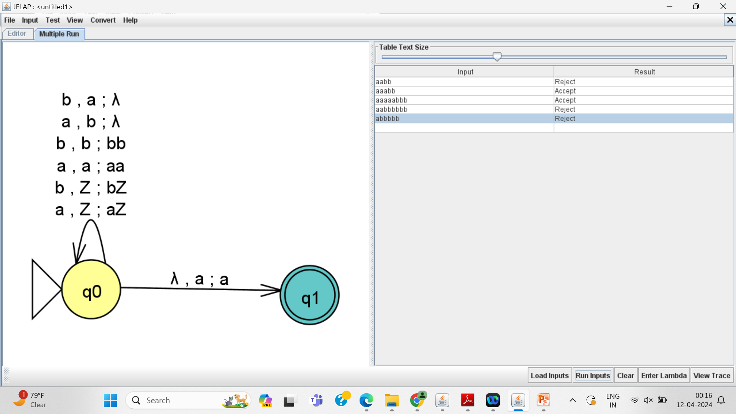

Slide 58
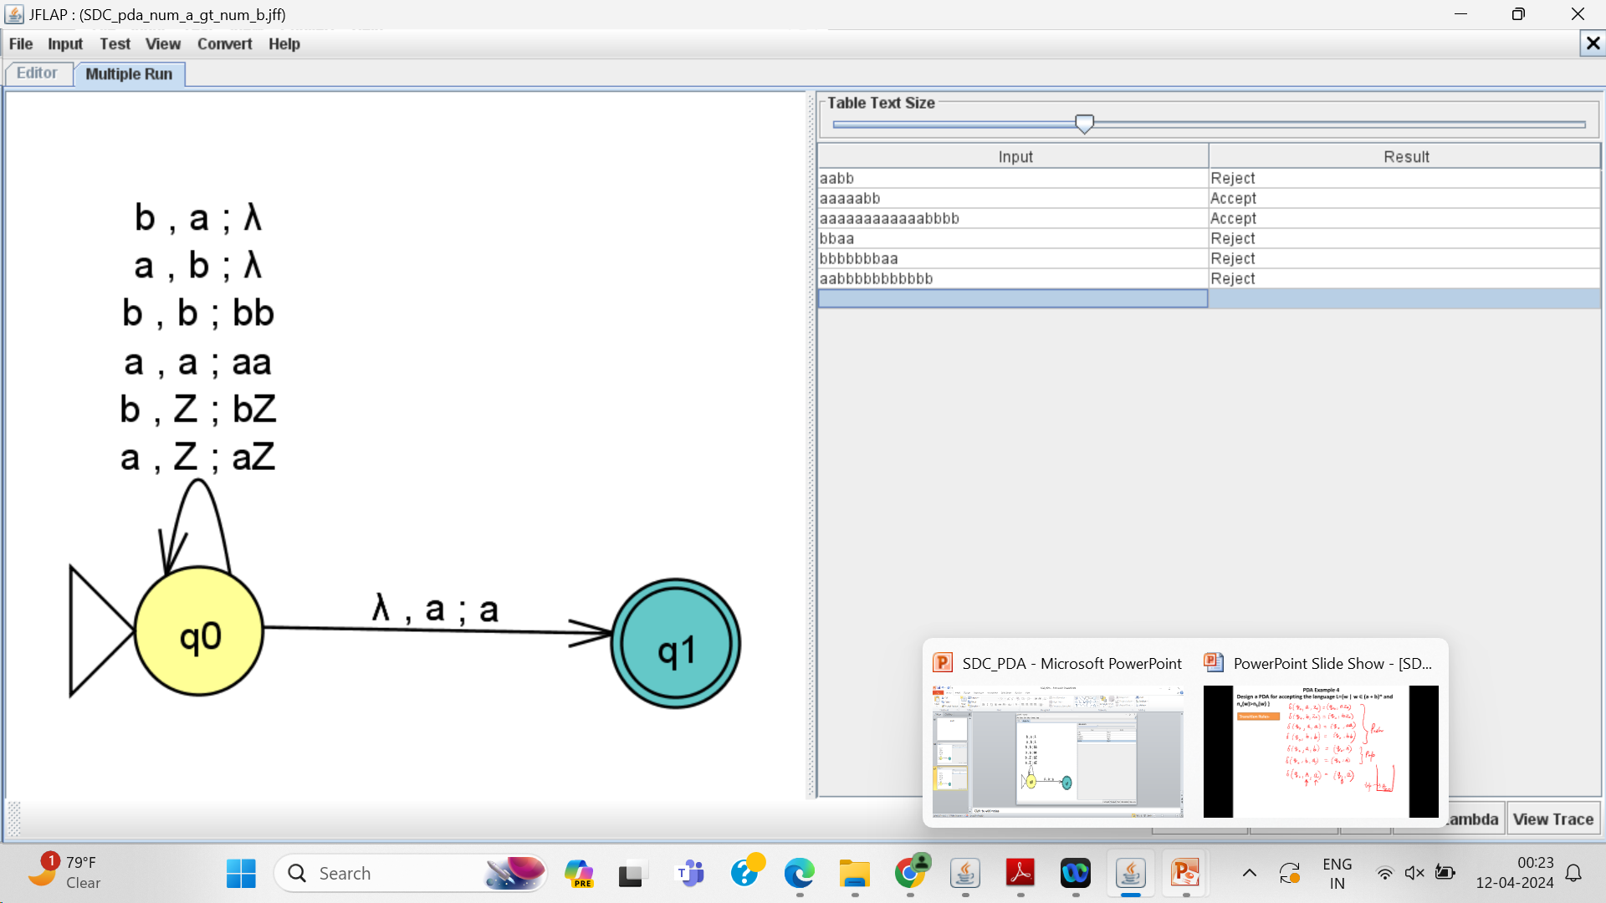

Slide 59
PDA Example 1
Design a PDA for accepting the language L={a^{n}b^{n}|n>=1}
Rules-
e

Slide 60
